Slide 1
2023 Second Quarter Outlook
Preparing to Land
<Enter Date>
--Rep Name
--Firm-Approved Title
--Registered Branch Address
--Approved Email and/or Registered Phone
--Securities Disclosure
Enter all information above and submit to Ad Review for final approval
Notes:
Introduction

Slide 2
What We Will Be Watching In The Second Quarter
Inflation
The Fed
The ECONOMY
Notes:
These are 3 major areas we are going to be watching in the second quarter. Inflation will ultimately drive the Fed’s decisions which will determine the economic landing. Will we enter a recession this year? Will it be mild or will it be deep? That’s the question we see pondered by investors. Will it be a soft or hard landing for the economy.

Slide 3
Inflation is Slowing
Notes:
First of all, we all know inflation is high, but it is slowing. This is looking at headline CPI, which is commonly quoted in the media.

Slide 4
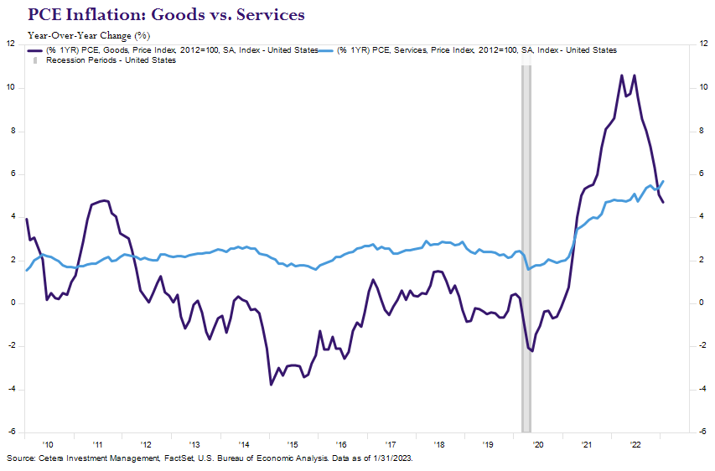
Breaking Down Inflation
Notes:
If we look at the Fed’s preferred inflation measure it tells a similar story. High but falling inflation. However, inflation is just a broad measurement, so let’s break it down a little more. This will also help us when we talk about the economy. Here we are looking at goods vs services inflation. Much of the inflation we experienced early on was good inflation due to supply chain disruptions caused by covid. You can see now goods inflation has come down dramatically as inventories have risen and companies are even selling goods at discounts to liquate inventories and make room for new inventories. However, inflation has shifted to the service side of the economy as people began traveling more and eating at restaurants more.

Slide 5

Notes:
The second thing we are watching closely is of course the Fed. The Fed was widely expected to pause their rate hikes in the second quarter. Much of the reaction in both bond and stock markets have been centered around what the Fed may do. This can make for confusing headlines. Good news becomes bad news, because good economic data could cause the Fed to be more aggressive.

Slide 6
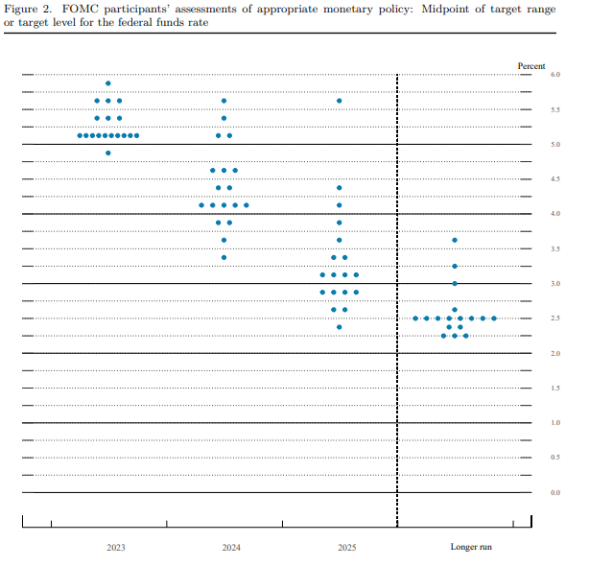
Hawkish Dot Plot
Source: Federalreserve.gov; Data as of 3/22/2023
Notes:
The current range is now 4.75-5.00% and based on the most recent Fed dot plot, this there is expected to be one more rate increase and then a pause. Markets don’t believe this and are anticipating rate cuts.

Slide 7
Investors Don’t Believe the Fed
Notes:
With the recent news around failed banks, investors think the Fed will cut rates in 2023. The last chart showed the median Fed Funds rate at 5.1% at the end of 2023. Investors think the Fed Funds rate will be closer to 4% currently. That is a wide margin and shows investors and the Fed are not currently on the same page, which will ultimately lead to volatility.

Slide 8

The Landing
Notes:
Since the Fed has started taper their rate hikes investors are looking for when the Fed will stop and pause. This could happen in the second quarter, but the question on everyone’s mind is how will the economy land? Will it be a rough landing (aka a recession) or will it be a soft landing (mild recession or no recession at all).

Slide 9
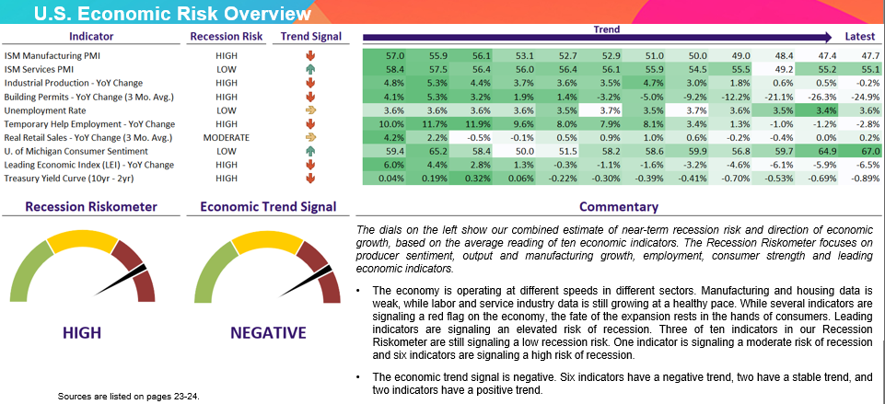
Chartbook – Recession Riskometer
Notes:
Economic data is signaling an elevated risk of recession. This is our chartbook which aggregates economic data in one place. We look at the trends as well as the overall level of the indicators, which include the labor market, housing market, manufacturing, services and others.

Slide 10
The tide goes out
Notes:
Before we talk about the different economic landings. Let’s talk about the big elephant in the room in the first quarter. We don’t think the Fed broke the banking system. It merely exposed a few banks that were taking excess risks. However, this is more than just a banking problem. While these banks may have been mismanaged, the Fed rate hikes are what exposed these banks. The Fed hiked rates at a very aggressive pace, playing catchup for not raising rates all of 2021. Without time to go gradually and see the impact they were having on the economy, the Fed was forced to go fast, raising the potential to break areas of the economy that had benefited from their zero-interest rate policy. Some companies are reliant on cheap borrowing costs and especially many start-up companies. Banks that were overexposed to such companies and didn’t have a diversified base of customers, saw runs on the bank as their customers moved in tandem to use cash to fund operations when their investor capital dried up. The Credit Suisse troubles were also well document. The scandal ridden bank had been in financial trouble for some time. The bank failures appear to be contained at this point. That being said, the banking troubles will tighten lending standards, which may even act as a rate hike. Fed Chair Powell even allude to this, and suggested future rate hikes could be less because of this tightening of lending standards.

Slide 11
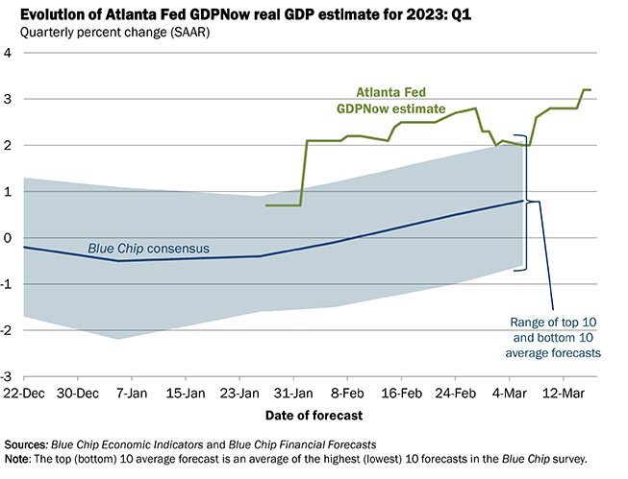
2023 Recession Not Guaranteed
Source: Atlanta Fed; Data as of 3/16/2023
Notes:
A recession is not guaranteed. The Atlanta Fed is forecasting second quarter growth to be near 3%, over the consensus estimates among economists differ.

Slide 12
Hard Landing
Notes:
The bear case of a hard landing, or deep recession, can be made due to stubbornly high inflation. After all, that is why the Fed is aggressively hiking interest rates. Inflation can be tricky to measure, and it isn’t the same for everyone. We like to look at different metrics to gauge inflation, not just the headline consumer price index, which is often quoted in the media. For example, we follow the 16% trimmed mean index, which removes the top and bottom 8% of inflation categories and averages the remaining ones. It allows us to better gauge how inflation may be stripping out outliers at a broad level. As you can see here, inflation on a broad basis has been rising again over the last couple of months. While this is just two data points, it is starting to look like a trend and the bear case scenario could be made that inflation isn’t under control and the Fed will have to continue to raise rates, creating collateral damage to the economy. The Fed has no choice but to hurt the economy to tame inflation.

Slide 13
Soft Landing
Notes:
The soft-landing scenario, or middle-of-the road scenario, is that we will experience a mild recession, and it remains our thesis. While inflation is a problem, we think the Fed rate hikes are having an impact, but there is a lag. As mentioned earlier, companies that relied on zero-interest rate policies are struggling, but we think most companies are better positioned to weather the increase in borrowing costs. Many refinanced at cheap interest rates and used that opportunity to clean up their balance sheets. Homeowners did the same, as 90% of all mortgages are 30-year and 15-year fixed rate mortgages and home equity levels are coming off 50-year highs. We currently see a scenario where the Fed takes a pause soon and it is still possible rates will be cut later in the year if inflation does show improvement and economic growth slows. Meanwhile, manufacturing, which we expect to get hit first, is holding up. While in a mild contraction, it isn’t doing as poorly. This sector benefited from stimulus money and the stay-at-home economy but was expected to struggle as consumers began shifting attention to the services sector. This chart shows the Institute of Supply Management Manufacturing Purchasing Managers Index. This index is based on surveys of business leaders in the manufacturing sector and is forward-looking, asking these decision makers questions about the future. Will they be hiring or laying off workers? Will they build inventory levels? You can see the index is below 50, which is signaling a contraction, but currently the index isn’t as bad as many feared.

Slide 14
No Landing – Rolling Recession
Notes:
The no-landing scenario is the most bullish, or goldilocks, scenario–the one with no recession at all. Proponents of this thesis often talk about a rolling recession, in which certain sectors of the economy experience a recession but the broad economy avoids one. The best argument for this scenario is the labor market. The unemployment rate was recently at 50-year lows and there are nearly 2 job openings for every job seeker, as seen here. Labor market strength is undeniable, and as a consumer-driven economy, this is very positive. When consumers don’t fear finding a new job if they lose their current one, they tend to spend money. While this is optimistic, we do note that these conditions can change quickly. The unemployment rate tends to come down gradually over long periods of time but can jump up dramatically when a recession happens.
Overall this paints a picture of an economy that is down, but not dire, - No steep recession. A soft landing

Slide 15

Uncertainty
Notes:
There is a lot of uncertainty now that cracks in the economy are starting to show. The Fed’s impact is being felt and expectations what the Fed will do widely differ from what the Fed is saying they will do.

Slide 16
China: Wild Card
Notes:
China as well as the rest of Asia’s reopening could cause inflation as demand to surge causing global inflation. Geopolitical tensions are rising as well and this can lead to energy disruptions and inflation in that sector once again. These are things we will be watching closely.

Slide 17
Stock Market
Notes:
The first quarter was a great reminder of how fast investor expectations can change in a Fed rate hike cycle and the volatility that can ensue. 2023 started with an equity rally. The S&P 500 climbed over 10%, as investors expected the Fed to pause and even pivot and lower interest rates later in the year. Strong economic data and aggressive signaling from the Fed changed that view and stock markets contracted accordingly. As quarter-end approached, we started to see a few bank closures in the U.S. and worries about a major bank in Switzerland, leaving investors confused at first. Was this bad news actually good news because the Fed can stop their rate hikes? Or was this just bad news? As we approached the March Fed meeting, the S&P 500 had given up nearly all its gains for the year. You can see you the S&P 500 is now close to its 50 and 200 day moving average too. The S&P 500 does not appear cheap from a valuation perspective, but it is less expensive as when it started 2022.

Slide 18
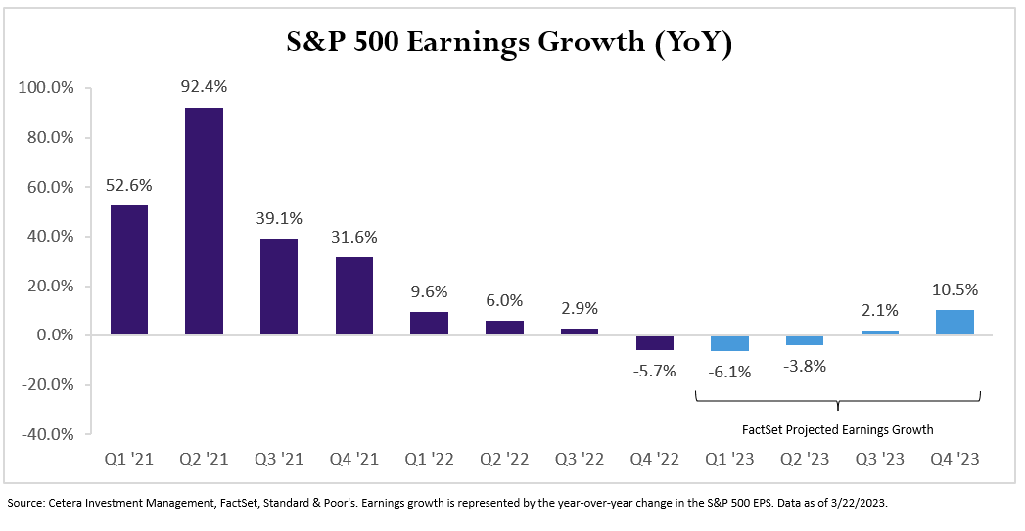
More Revisions to Earnings Needed
Notes:
Long term stock returns are generally driven by corporate earnings. Earnings expectations have been lowered and probably will continue to be lowered for the foreseeable future. The current outlook is for single-digit negative earnings growth in the first and second quarters, with positive single-digit growth in the third and fourth quarters. For the year, earnings growth is predicted to be slightly positive. As we discussed in our 2023 Outlook, expectations are low and continue to be lowered. With our thesis of a soft-landing scenario, this could provide for upside surprises later in the year as companies increase profit margins if inflation starts to fall and the Fed pauses or even pivots and lowers rates.

Slide 19
Bond Market Volatility
Notes:
Volatility in bonds has been high as expectations around Fed policy change. You can see the large swings in the 10-year Treasury yield recently in this chart. Bonds suffered their first double-digit annual loss on record last year, but the risk-and-return dynamics changed with rising bond yields. Bond prices rise when bond yields fall, so this year has started out well for bond investors holding high-quality bonds. With a potential recession on the horizon and prospects of a less aggressive Fed, high-quality bonds could continue to perform well. In addition, if yields don’t move from where they currently are, bond investors could get decent yields just holding on to them. Bonds can also protect against equity volatility. When constructing a bond portfolio, your financial professional can help you create one that suits your specific goals and objectives.

Slide 20
Thank You
For more recent updates follow us on Twitter @CeteraIM
Notes:
Thank you

Slide 21
Disclosures
About Cetera® Investment Management
Cetera Investment Management LLC is an SEC registered investment adviser owned by Cetera Financial Group®. Cetera Investment Management provides market perspectives, portfolio guidance, model management, and other investment advice to its affiliated broker-dealers, dually registered broker-dealers and registered investment advisers.
About Cetera Financial Group
“Cetera Financial Group” refers to the network of independent retail firms encompassing, among others, Cetera Advisors LLC, Cetera Advisor Networks LLC, Cetera Investment Services LLC (marketed as Cetera Financial Institutions or Cetera Investors), and Cetera Financial Specialists LLC. All firms are members FINRA / SIPC. Located at 655 W. Broadway, 11th Floor, San Diego, CA 92101.
Individuals affiliated with Cetera firms are either Registered Representatives who offer only brokerage services and receive transaction-based compensation (commissions), Investment Adviser Representatives who offer only investment advisory services and receive fees based on assets, or both Registered Representatives and Investment Adviser Representatives, who can offer both types of services.
The material contained in this document was authored by and is the property of Cetera Investment Management LLC. Cetera Investment Management provides investment management and advisory services to a number of programs sponsored by affiliated and non-affiliated registered investment advisers. Your registered representative or investment adviser representative is not registered with Cetera Investment Management and did not take part in the creation of this material. He or she may not be able to offer Cetera Investment Management portfolio management services.
Nothing in this presentation should be construed as offering or disseminating specific investment, tax, or legal advice to any individual without the benefit of direct and specific consultation with an investment adviser representative authorized to offer Cetera Investment Management services. Information contained herein shall not constitute an offer or a solicitation of any services. Past performance is not a guarantee of future results.

Slide 22
Disclosures
For more information about Cetera Investment Management, please reference the Cetera Investment Management LLC Form ADV disclosure brochure and the disclosure brochure for the registered investment adviser your adviser is registered with. Please consult with your adviser for his or her specific firm registrations and programs available.
No independent analysis has been performed and the material should not be construed as investment advice. Investment decisions should not be based on this material since the information contained here is a singular update, and prudent investment decisions require the analysis of a much broader collection of facts and context. All information is believed to be from reliable sources; however, we make no representation as to its completeness or accuracy. The opinions expressed are as of the date published and may change without notice. Any forward-looking statements are based on assumptions, may not materialize, and are subject to revision.
All economic and performance information is historical and not indicative of future results. The market indices discussed are not actively managed. Investors cannot directly invest in unmanaged indices. Please consult your financial advisor for more information.
Additional risks are associated with international investing, such as currency fluctuations, political and economic instability, and differences in accounting standards.
A diversified portfolio does not assure a profit or protect against loss in a declining market.
The S&P 500 is a capitalization-weighted index of 500 stocks designed to measure performance of the broad domestic economy through changes in the aggregate market value of 500 stocks representing all major industries.

Slide 23
Data Sources
Economic Indicator Source
New Home Sales U.S. Bureau of the Census
S&P/Case-Shiller Home Price Index (20 city) - YoY Change S&P Dow Jones Indices LLC
Total Construction Spending - YoY Change U.S. Bureau of the Census
ISM Manufacturing Composite PMI Institute for Supply Management
ISM Manufacturing New Orders Institute for Supply Management
ISM Services Composite PMI Institute for Supply Management
ISM Services New Orders Institute for Supply Management
U. of Michigan Consumer Sentiment University of Michigan
Consumer Price Index (CPI) - YoY Change U.S. Bureau of Labor Statistics
Personal Consumption Expenditure (PCE) - YoY Change U.S. Bureau of Economic Analysis
Producer Price Index (PPI) - YoY Change U.S. Bureau of Labor Statistics
Average Hourly Earnings - YoY Change U.S. Bureau of Labor Statistics
Real GDP – QoQ (SAAR) U.S. Bureau of Economic Analysis
Real GDP – YoY Change U.S. Bureau of Economic Analysis
Treasury Yield Curve (10-Yr. Minus 2-Yr.) Federal Reserve Bank of St. Louis
Leading Economic Index (LEI) – YoY Change The Conference Board

Slide 24
Data Sources
Economic Indicator Source
New Home Sales U.S. Bureau of the Census
S&P/Case-Shiller Home Price Index (20 city) - YoY Change S&P Dow Jones Indices LLC
Total Construction Spending - YoY Change U.S. Bureau of the Census
ISM Manufacturing Composite PMI Institute for Supply Management
ISM Manufacturing New Orders Institute for Supply Management
ISM Services Composite PMI Institute for Supply Management
ISM Services New Orders Institute for Supply Management
U. of Michigan Consumer Sentiment University of Michigan
Consumer Price Index (CPI) - YoY Change U.S. Bureau of Labor Statistics
Personal Consumption Expenditure (PCE) - YoY Change U.S. Bureau of Economic Analysis
Producer Price Index (PPI) - YoY Change U.S. Bureau of Labor Statistics
Average Hourly Earnings - YoY Change U.S. Bureau of Labor Statistics
Real GDP – QoQ (SAAR) U.S. Bureau of Economic Analysis
Real GDP – YoY Change U.S. Bureau of Economic Analysis
Treasury Yield Curve (10-Yr. Minus 2-Yr.) Federal Reserve Bank of St. Louis
Leading Economic Index (LEI) – YoY Change The Conference Board

Slide 25
Thank You
For more recent updates follow us on Twitter @CeteraIM
Notes:
Thank you

